Slide 1

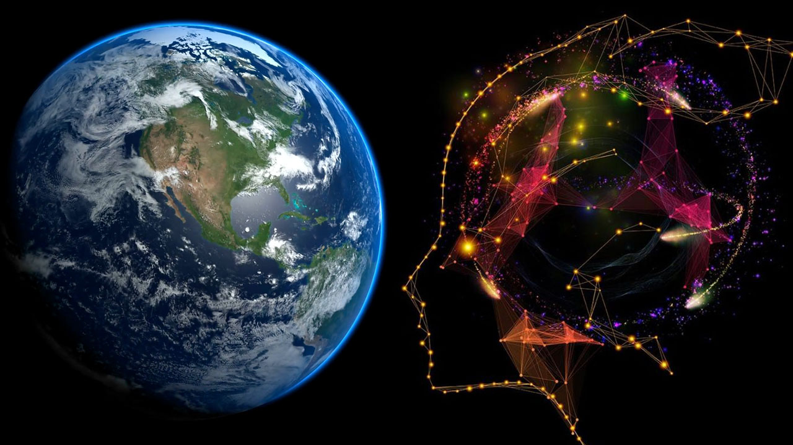
Spatial Machine Learning
Introduction to Spatial Data and Machine Learning
Dr. Giri Rajasekhar Gunnu
Professor of Practice, Andhra University
📧 g.giri.iitm@gmail.com
🔗 LinkedIn: girigunnu

Slide 2
(Sources and Formats of Data)
Foundations of Spatial Data
1

Slide 3
Sources of Spatial Data
Remote Sensing
Acquiring information about an object or phenomenon without making physical contact.
Primarily carried out by satellites and aircraft sensors that measure emitted and reflected electromagnetic radiation.
Excellent for covering massive areas and for continuous monitoring.
Global Positioning System (GPS)
A satellite-based navigation system providing location and time information.
Used to collect precise coordinates (points) in the field.
Essential for ground-truthing data collected by remote sensing.
Geographic Information Systems (GIS)
While GIS is a system for managing and analyzing spatial data, it is also a source of new data created through analysis (e.g., buffering, overlay analysis).
Often contains existing vector and raster data layers from various sources.

Slide 4
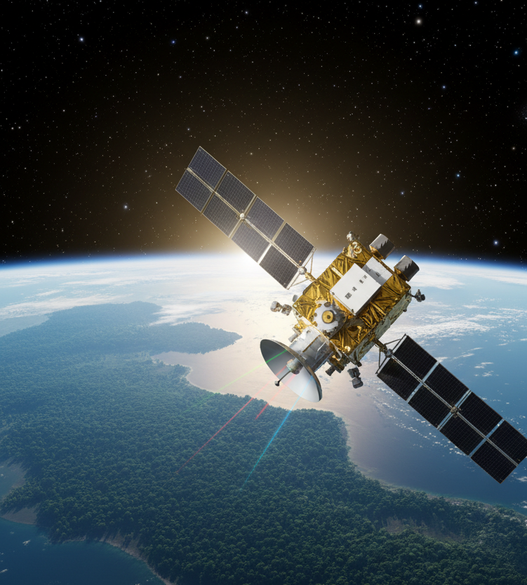
Sources of Spatial Data
Remote Sensing
Acquiring information about an object or phenomenon without making physical contact.
Primarily carried out by satellites and aircraft sensors that measure emitted and reflected electromagnetic radiation.
Excellent for covering massive areas and for continuous monitoring.
example of what a remote sensing satellite might look like in orbit, capturing data

Slide 5
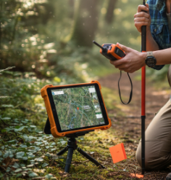
Sources of Spatial Data
Global Positioning System (GPS)
A satellite-based navigation system providing location and time information.
Used to collect precise coordinates (points) in the field.
Essential for ground-truthing data collected by remote sensing.
someone using a GPS for ground-truthing

Slide 6
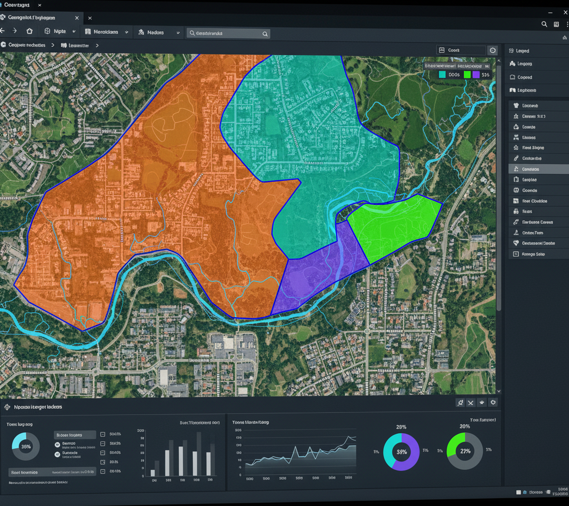
Sources of Spatial Data
Geographic Information Systems (GIS)
While GIS is a system for managing and analyzing spatial data, it is also a source of new data created through analysis (e.g., buffering, overlay analysis).
Often contains existing vector and raster data layers from various sources.
detailed map with various overlaid data layers, similar to what you'd see in a GIS application

Slide 7
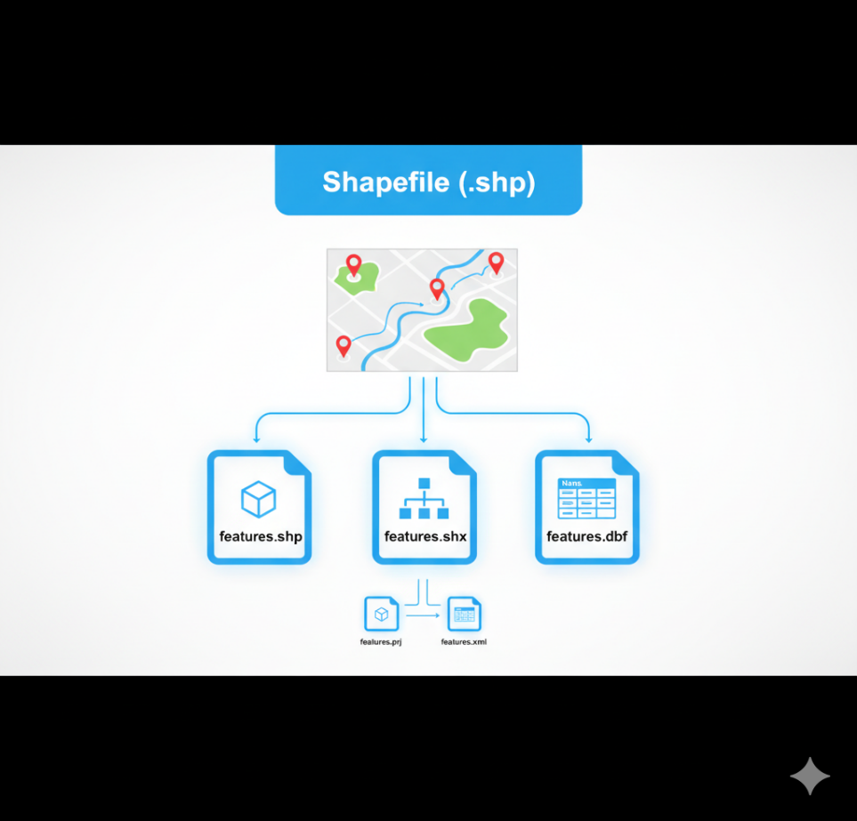

Common Spatial Data Formats
Shapefile (.shp)
A popular vector data format developed by Esri.
Stores non-topological geometry and attribute information for spatial features.
A "shapefile" is actually a collection of multiple files (.shp, .shx, .dbf are mandatory).
concept of a shapefile, showing a digital representation of spatial data layers (like points, lines, and polygons) that would be stored within such a format, along with the idea of its multiple component files

Slide 8
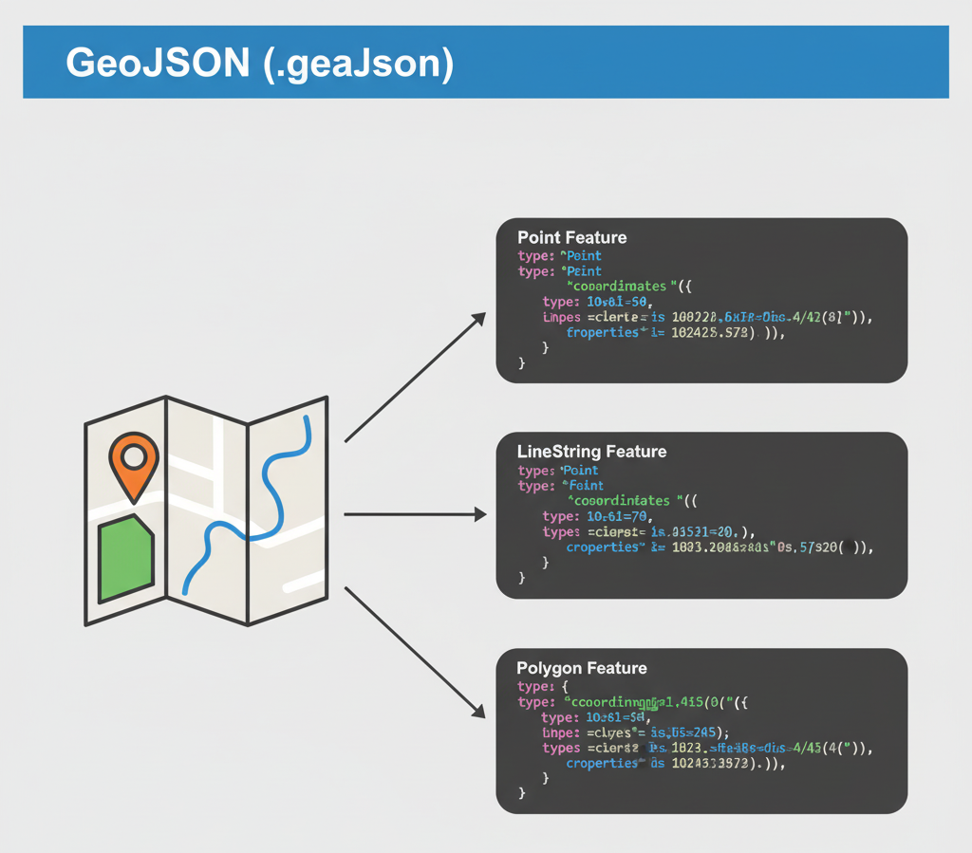
Common Spatial Data Formats
GeoJSON (.geojson)
An open-standard format for encoding geographic data structures using JSON (JavaScript Object Notation).
Lightweight and easily readable by both humans and machines, making it ideal for web-based mapping applications.

Slide 9
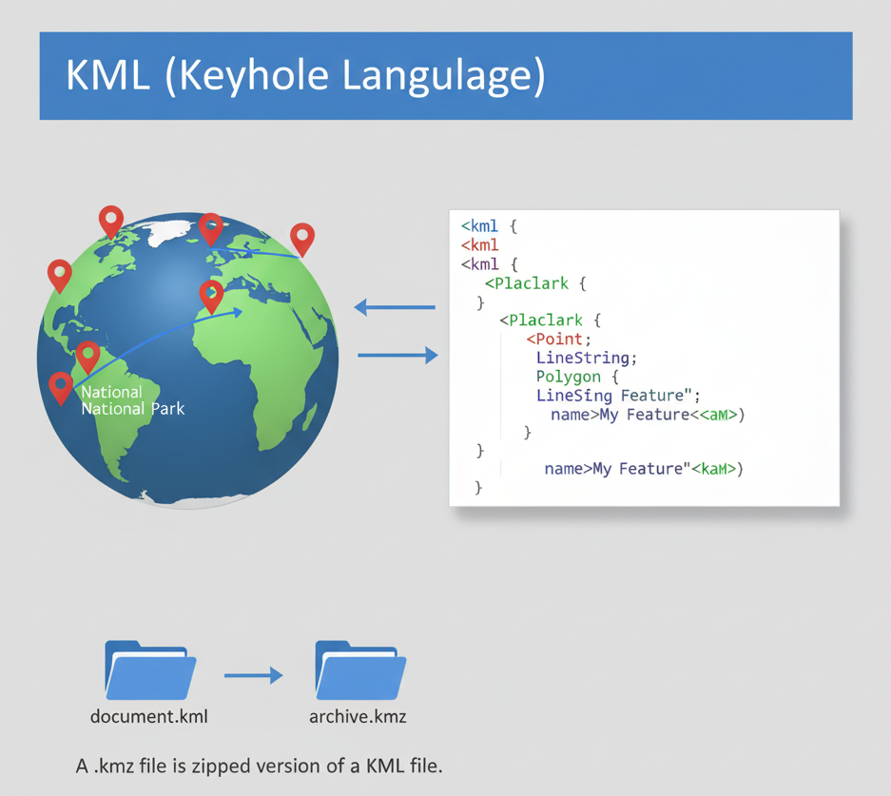
Common Spatial Data Formats
KML (Keyhole Markup Language)
An XML-based file format for representing geographic data in an Earth browser such as Google Earth.
Can contain points, lines, polygons, and imagery. A .kmz file is a zipped version of a KML file.

Slide 10
Introduction to Machine Learning
What is Machine Learning?
A field of artificial intelligence (AI) that gives computers the ability to learn from data without being explicitly programmed.
Machine learning algorithms build a model based on sample "training data" to make predictions or decisions.
Our Focus: Applying these algorithms to spatial data to uncover geographic patterns, predict location-based outcomes, and classify spatial features.

Slide 11
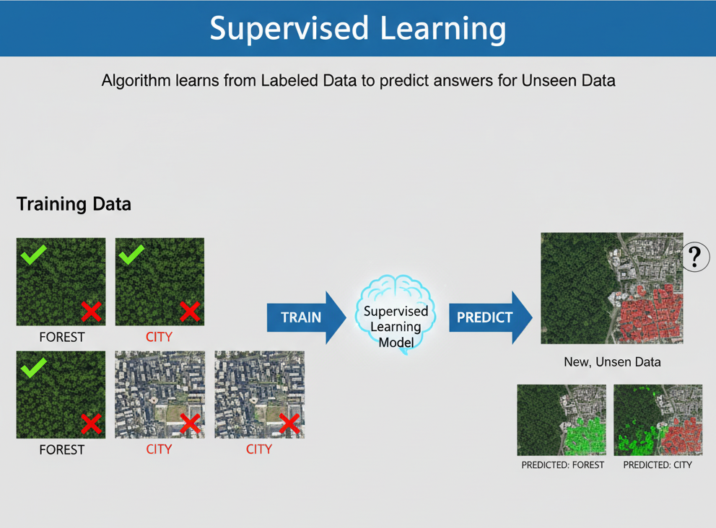
Supervised Learning
The algorithm learns from a labeled dataset, where each data point is tagged with a correct answer.
Goal: To learn a rule that can predict the answer for new, unseen data.
Example: Using satellite images already labeled as "forest" or "city" to train a model that can classify new images.

Slide 12
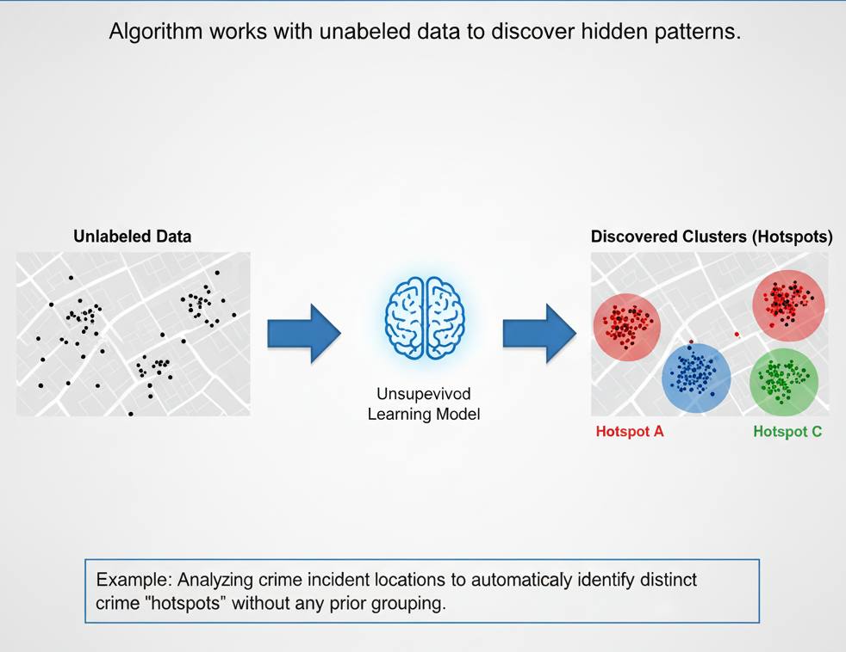
Unsupervised Learning
The algorithm works with an unlabeled dataset.
Goal: To discover hidden patterns or natural groupings within the data.
Example: Analyzing crime incident locations to automatically identify distinct crime "hotspots" without any prior grouping.

Slide 13
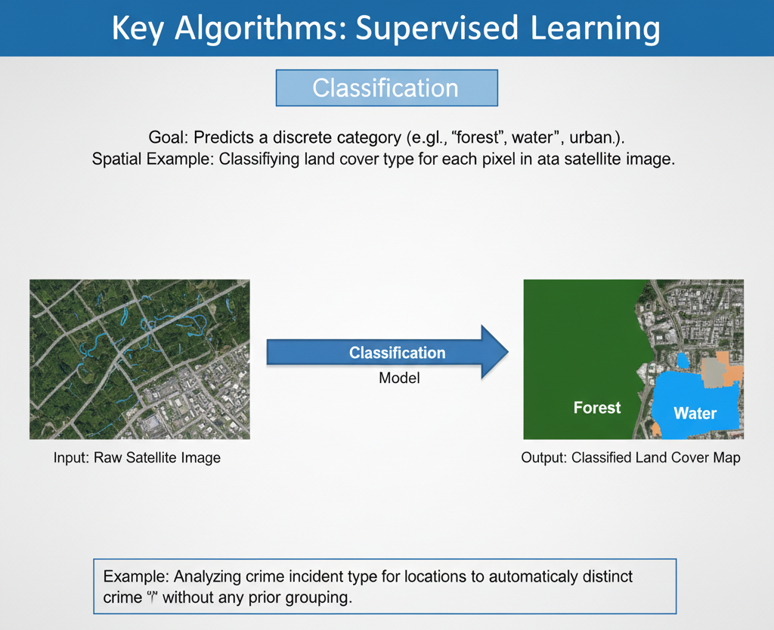
Key Algorithms- Supervised Learning
Classification
Goal: Predicts a discrete category (e.g., 'forest', 'water', 'urban').
The model learns from data where the categories are already known.
Spatial Example: Classifying land cover type for each pixel in a satellite image.

Slide 14
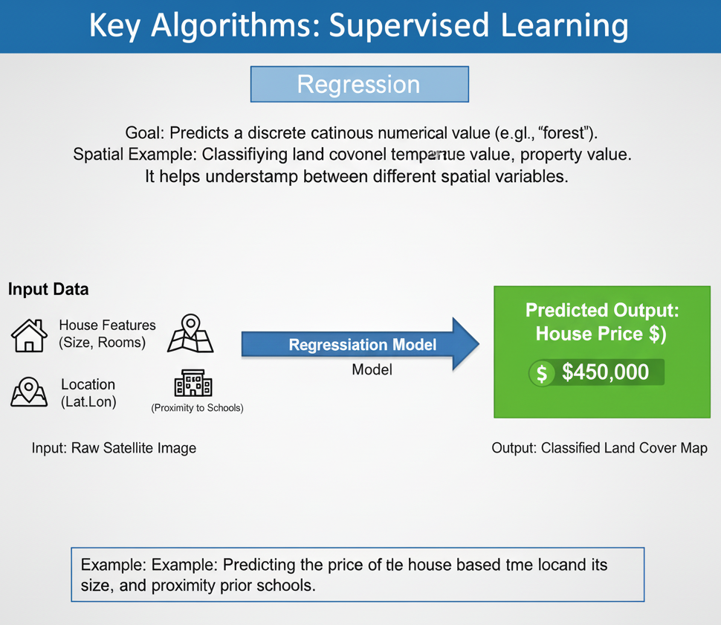
Key Algorithms- Supervised Learning
Regression
Goal: Predicts a continuous numerical value (e.g., temperature, property value).
It helps understand the relationship between different spatial variables.
Spatial Example: Predicting the price of a house based on its location, size, and proximity to schools.

Slide 15
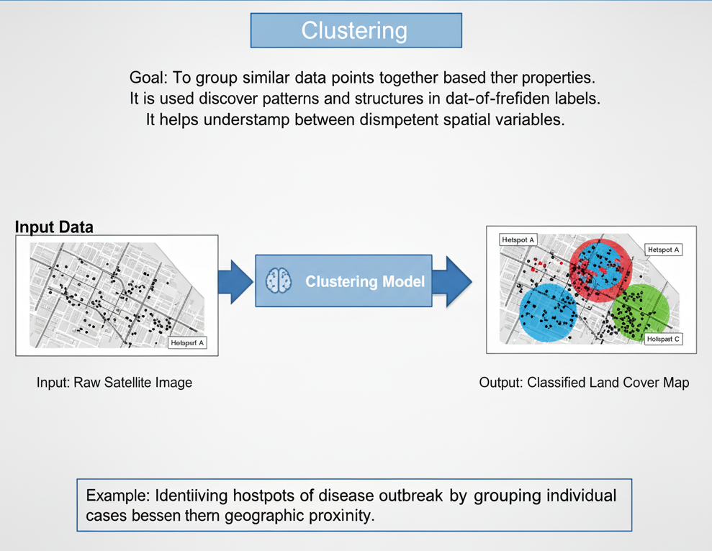
Key Algorithms- Unsupervised Learning
Clustering
Goal: To group similar data points together based on their properties.
It is used to discover patterns and structures in data without pre-defined labels.
Spatial Example: Identifying hotspots of disease outbreaks by grouping individual cases based on their geographic proximity.

Slide 16
Evaluating Classification Models
To measure how good our classification model is, we use a set of standard metrics. These metrics are calculated from a Confusion Matrix.
Core Metrics:
Accuracy: What percentage of predictions were correct overall? (Good for balanced datasets).
Precision: Out of all the times the model predicted a certain class, how often was it right? (Measures correctness).
Recall: Of all the actual instances of a class, how many did the model find? (Measures completeness).
F1 Score: A single score that balances Precision and Recall. Useful when class distribution is uneven.

Slide 17
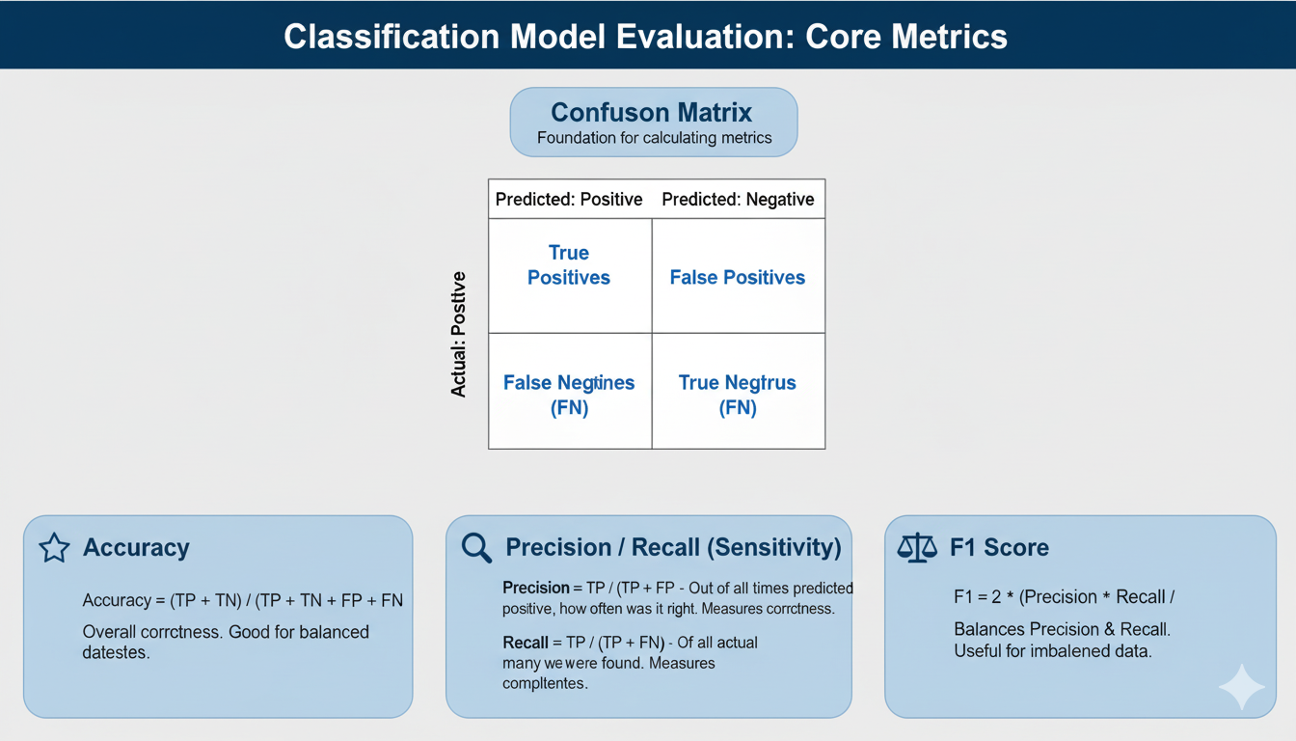

Slide 18

Myself
Dr. Giri Rajasekhar Gunnu
AI, Digital Twin & Industry Solutions Specialist | Industry 4.0 Specialist | Predictive Solutions Expert | Marine and Offshore Consultant
Professor of Practice, Andhra University
📧 g.giri.iitm@gmail.com
🔗 LinkedIn: girigunnu

Slide 19
Q&A
Welcome your questions and insights from all ranks
Your feedback helps us improve our CBPM implementation and ensures it meets the real-world needs of our fleet

